Slide 1
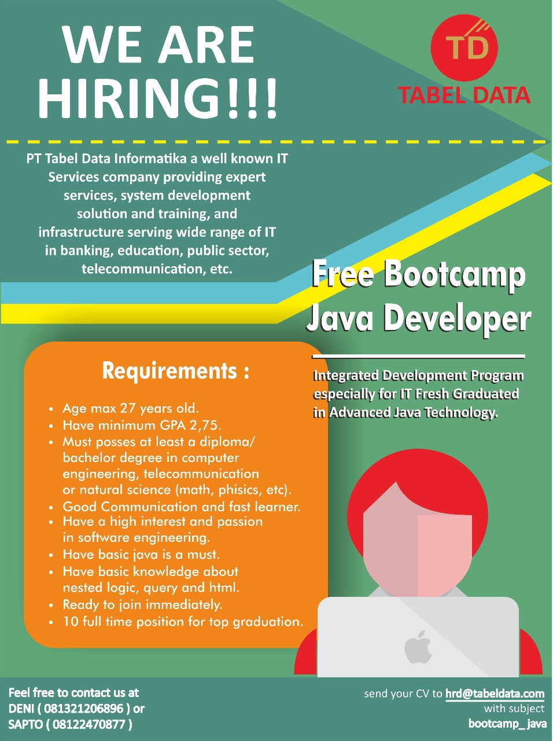
Bootcamp Java Developer #Day 2
PT. Tabel Data Infromatika
By Dimas Maryanto,S.Kom

Slide 2
Hibernate Object Relational Mapping
Hibernate ORM enables developers to more easily write applications whose data outlives the application process. As an Object/Relational Mapping (ORM) framework, Hibernate is concerned with data persistence as it applies to relational databases (via JDBC)

Slide 3
Setup Project
Hibernate.cfg.xml
SessionFactory
Session

Slide 4
Istilah dalam Hibernate
Domain Model
Data Accessing
Assocations
OneToOne
OneToMany
ManyToOne
ManyToMany
Object Oriented Persistence
Embedded Mapping
Collections
SQL Native
HQL
Criteria API

Slide 5
Entity

Slide 6
Embedded

Slide 7
Assosiation OneToOne

Slide 8
Association OneToMany

Slide 9
Association ManyToOne

Slide 10
Association ManyToMany

Slide 11
Saving an Object

Slide 12
Getting an object

Slide 13
Hibernate Query Language

Slide 14
Criteria API

Slide 15
Inheritance in Hibernate

